Slide 1

Functional Programing
Ashkrit Sharma

Slide 2

FP Languages
Haskell
LISP
Clojure
Scala/F#
(+ 1 2)
Java 8/C#
plus(1,2)
o.plus(1,2)
Java Script/Python

Slide 3
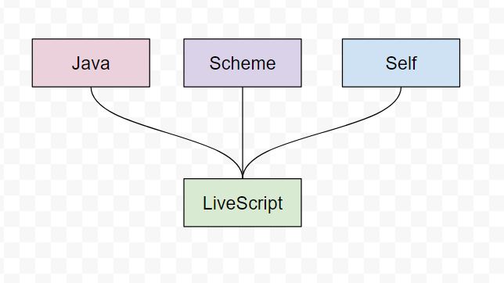
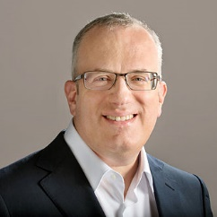
What is JavaScript
High Level
Dynamic & Untyped
Interpreted run-time language
Immortal
Assembly
Multi Paradigm
Imperative (Prototype-based)
Event driven
Functional programming
Brendan Eich, Created JS in 1995
Notes:
Got Developed in 10 Days in 1995
Zero Install language available on all device including mobile
Garbage collected
JIT compiler

Slide 4
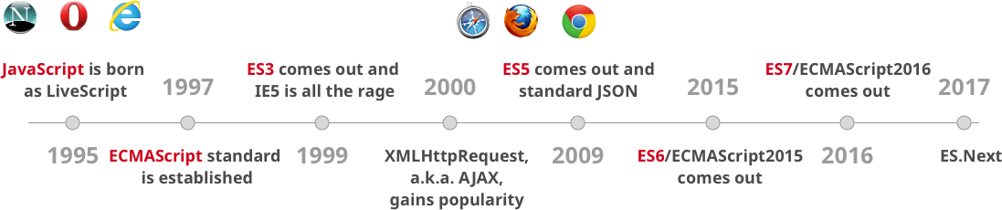
JavaScript History

Slide 5
JavaScript Type system
10 + 10
10 + “10”
10 + null
10 + [10]
10 + [10,20]
[10,20] + [10]
[10,20] + [null]
Math.min(null, 1234)
Math.min('1', 1234)
20
“1010”
10
"1010“
"1010,20“
"10,2010“
"10,20“
0
1

Slide 6

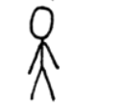
Imperative
Functional
Double all the even number and sum it
Double all the even number and sum it
Your answer is 40
Do it yourself
Program must communicate clearly to people not machine.

Slide 7
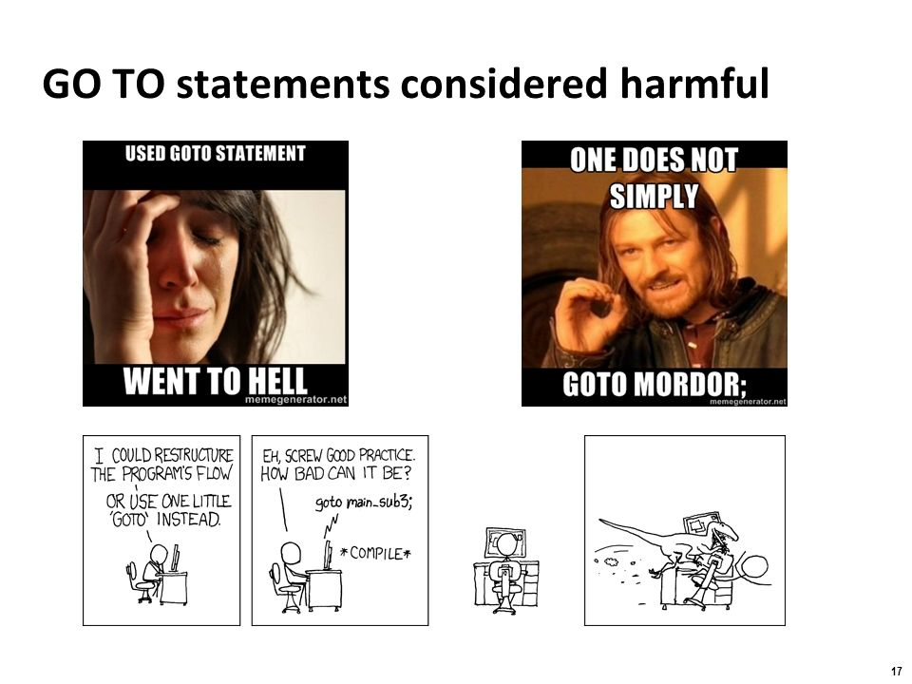
Imperative Vs FP
var numbers = [1,2,3,4,5,6,7,8,9];
function doItYourSelf(numbers) {
var sum=0;
for(var index = 0 ; index < numbers.length; index++)
{
if(numbers[index]%2==0) {
sum += numbers[index]*2;
}
return sum;
}
function iwillDo(numbers) {
return numbers
.filter( value => value%2==0)
.map(value => value*2)
.reduce((acc, currentValue) => acc+currentValue,0);
}
Loop consider harmful
Continue/Break are harmful
Mutation consider harmful

Slide 8
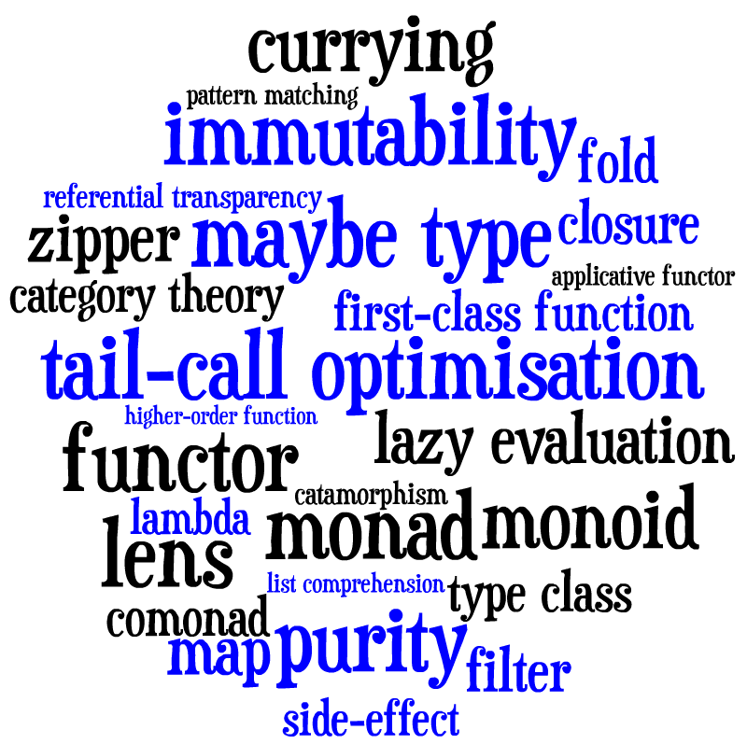
Keyword View of Functional Programming

Slide 9
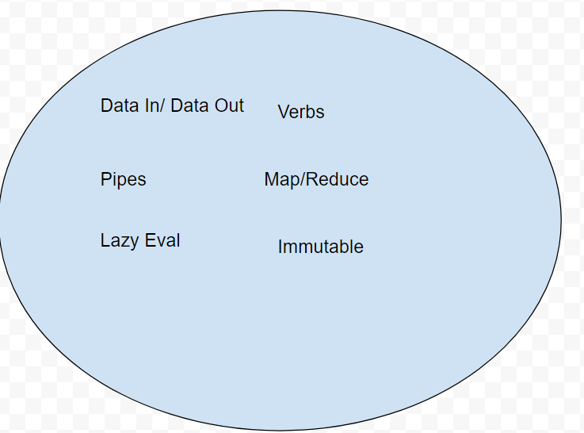
Function Programming Principle

Slide 10
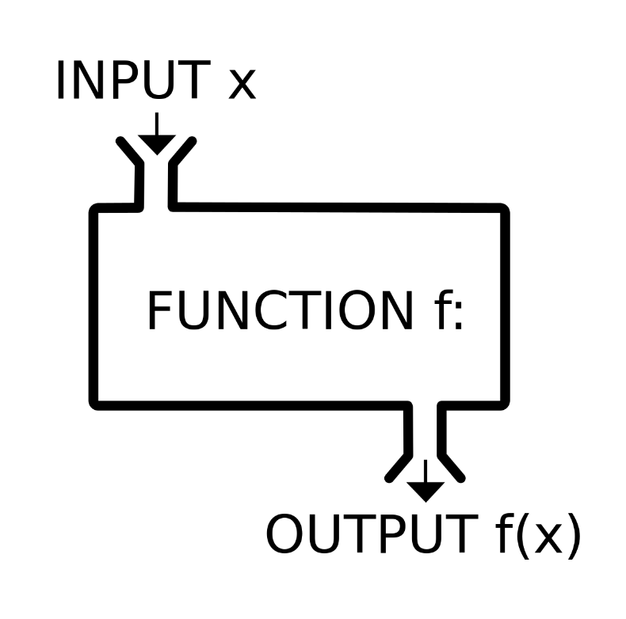
Data In -> Data out
Only need input to derive output
No read/write global state
Does not break data flow pipe. In case of exception also.

Slide 11
Data In -> Data out
let value = 10;
let plus1 = ++value;
let value = 10;
let plus1 = value + 1;
const cartItems = []
function addItems ( itemName, price,qty) {
cartItems.push( {
itemName,price,qty
});
}
function addItems(cartItems, itemName, price, qty) {
return cartItems.concat({
itemName, price, qty
});
}

Slide 12
Data In -> Data out
function printInCenter(str) {
var elem = document.createElement("div");
elem.textContent = str;
elem.style.position = 'absolute';
elem.style.top = window.innerHeight / 2 + "px";
elem.style.left = window.innerWidth / 2 + "px";
document.body.appendChild(elem);
}
function printOnScreen(str, height, width) {
var elem = document.createElement("div");
elem.textContent = str;
elem.style.position = 'absolute';
elem.style.top = height;
elem.style.left = width;
return elem;
}
pure function
Referential transparency
Side-Effect

Slide 13
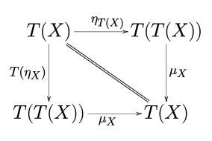
Data In -> Data out
10/0
Infinity/NAN
function findFirst(values,key) {
for(var index=0;index < values.length;index++) {
if(values[index].key == key) {
return MayBe.Of(values[index])
}
}
return MayBe.empty();
}
function uploadFile(filePath) {
try {
//Upload file
throw "Upload failed"
} catch (error) {
return ResponseOrError(MayBe.empty(),MayBe.Of(error));
}
}
Monad

Slide 14
Data In -> Data out
Cache function result( memorization)
Out of order/Parallel execution
Delay Execution
function f() {
console.log("Why i am called");
return 0;
}
var x = 9;
if(x === 10 && f() === 0 ) {
console.log("This is 10");
}
var y = f();
if(x === 10 && y === 0 ) {
console.log("This is 10");
}

Slide 15
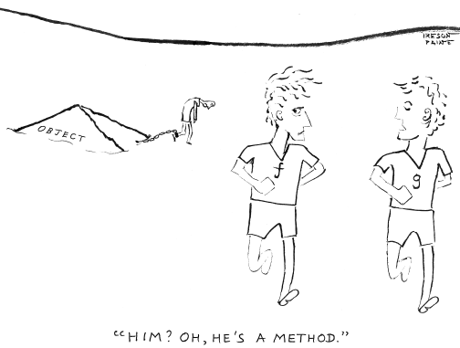
Verbs
Sometimes, the elegant implementation is a function. Not a method. Not a class. Not a framework. Just a function.
--John Carmack, lead programmer of the Doom video game
function f(value) {
return 1 + value;
}
var g = function(value) {
return 1 + value;
}
First Class function

Slide 16

More Verbs
function sumScores() {
var total = 0;
for (index = 0; index < scores.length; index++) {
total += scores[index];
}
return total;
}
function sum(values) {
var total = 0;
for (index = 0; index < values.length; index++) {
total += values[index];
}
return total;
}
function sumItems() {
var total = 0;
for (index = 0; index < items.length; index++) {
total += items[index];
}
return total;
}

Slide 17
High order Functions
function apply(values,fn, intialValue) {
var acc = intialValue;
for (index = 0; index < values.length; index++) {
acc = fn(acc,values[index]);
}
return acc;
}
console.log(apply([10,20],(x,y) => x+y, 0))
console.log(apply([10,20],(x,y) => x*y, 1))

Slide 18
High order Functions
function f_sum(values) { return values.reduce((acc,value) => {return acc+value;},0);
}
function f_mul(values) { return values.reduce((acc,value) => {return acc*value;},1);
}

Slide 19
High order Functions ( reduce)
[1 , 2 , 3 , 4 ]
(acc,value) => acc+value, 0
0
1
2
3
4
1
3
6
10

Slide 20
More Functions….. High Order ,
function reduceValue(values , fn, initialValue) {
return values.reduce((acc,value) => {
return fn(acc,value);
},initialValue);
}
reduceValue([1,2,3], function(x,y) { return x+y}, 0)
reduceValue([1,2,3,4], function(x,y) { return x * y}, 1)
reduceValue([ [1,2,3,4] , [10,20]], function(x,y) { return x.concat(y)}, [])
reduceValue([ 1,2,3,4,1,4], function(x,y) {
var count = x[y] || 0;
x[y] = count + 1;
return x;
}, {})

Slide 21


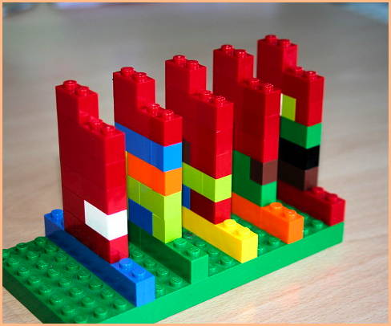
PIPE
Cat filename | grep | wc
count(grep(cat("samplefile"), "line"))
var fileLineCount = compose(cat, grep('home'), count)
console.log(fileLineCount('logs'))

Slide 22
Composition Via Chaining
Cat filename | grep ‘home’ | wc
cat('logs')
.filter(grepText('Home'))
.reduce(lineCount, 0)

Slide 23
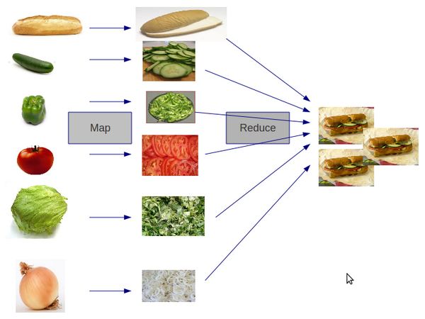
No Loops using map/reduce

Slide 24


Map/Reduce Examples

Slide 25
Curry & Partial Functions…..
function convertFX(value,rate) {
return value * rate;
}
console.log("INR" , convertFX(5, 45) )
console.log("HKD" , convertFX(5, 5) )
console.log("JPY" , convertFX(5, 80) )
function toCurrency(rate) {
return function(inrValue) {
return convertFX(inrValue,rate);
}
}
var toInr = toCurrency(45);
var toHKD = toCurrency(5);
var toJPY = toCurrency(80);

Slide 26
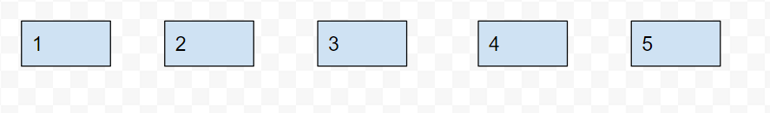
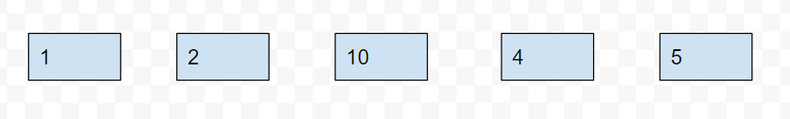
Immutable
Value[2]=10

Slide 27
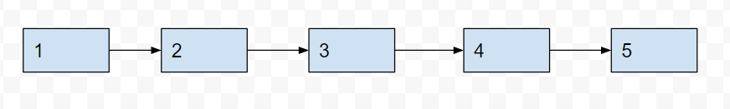
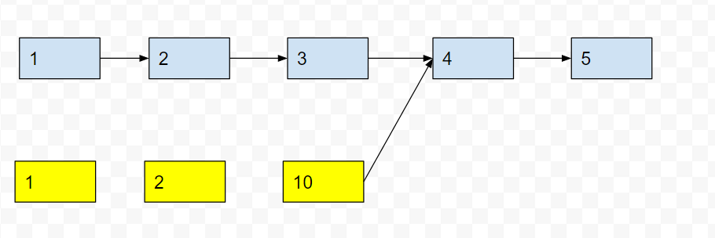
Immutable
- Clone (Copy on Write)
- Structural sharing

Slide 28
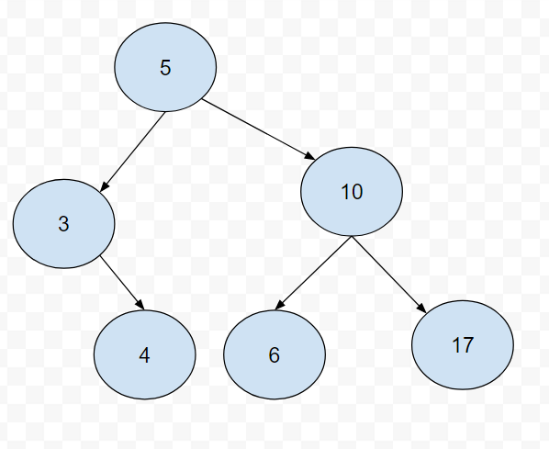
Immutable

Slide 29
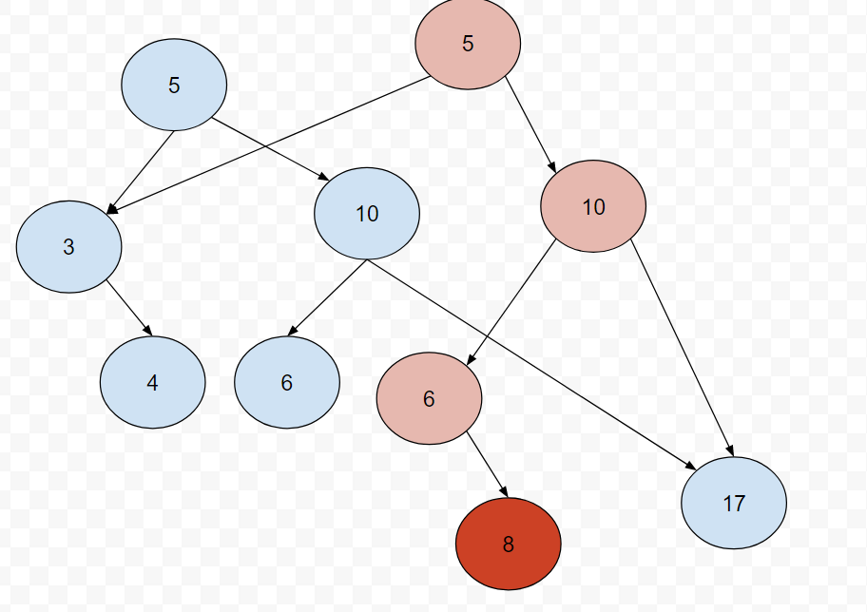
Immutable

Slide 30
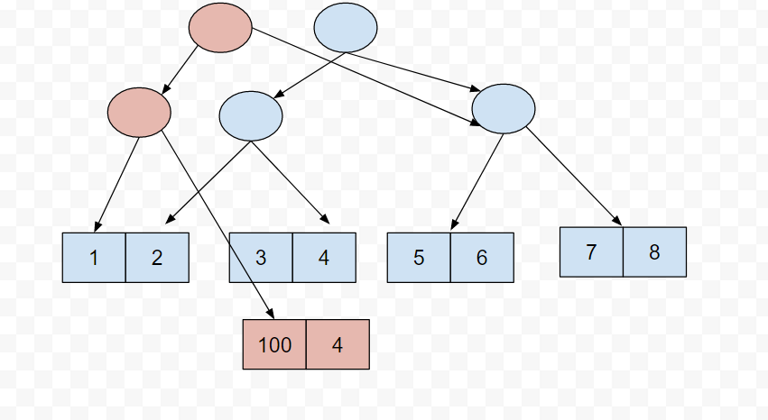
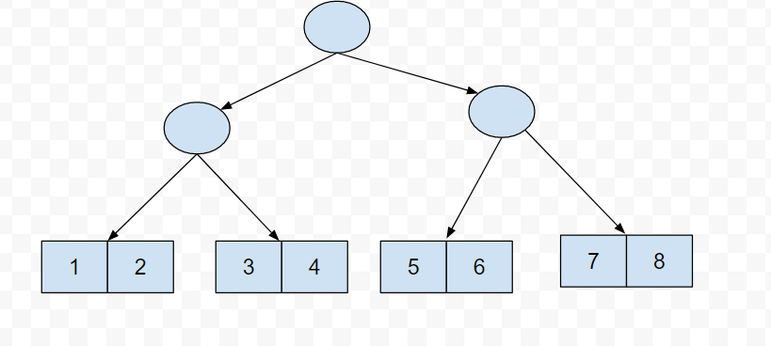
Immutable

Slide 31
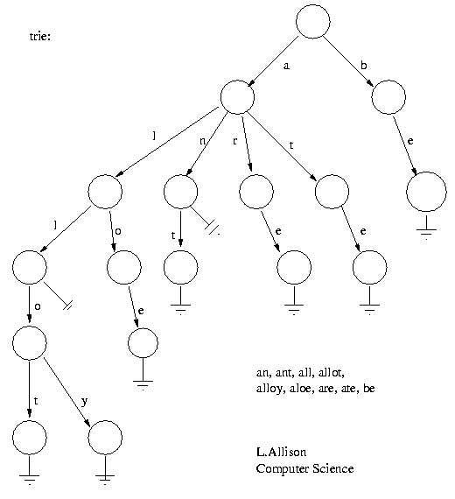
Immutable

Slide 32
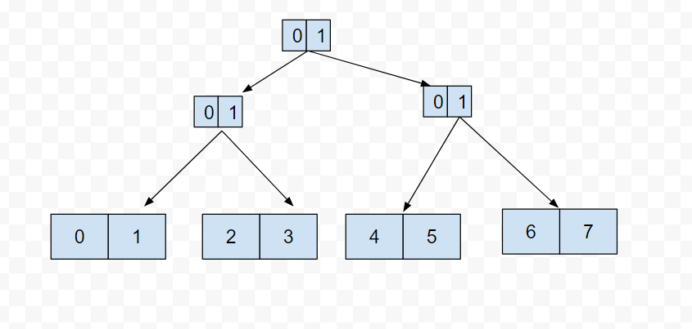
Immutable
0 - 000
3 - 011
7 - 111
Key | hash | toBinary

Slide 33
Resource
Code available @ https://github.com/ashkrit/jsfpexamples
https://facebook.github.io/immutable-js/
http://swannodette.github.io/mori/
http://es6-features.org/

